Slide 1
Multiplication

Slide 2
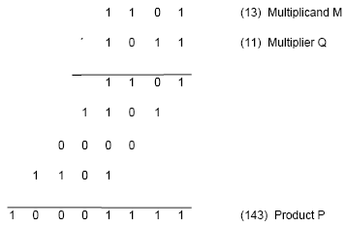
Multiplication of unsigned numbers
Product of 2 n-bit numbers is at most a 2n-bit number.
Unsigned multiplication can be viewed as addition of shifted
versions of the multiplicand.

Slide 3
Multiplication of unsigned numbers (contd..)
We added the partial products at end.
Alternative would be to add the partial products at each stage.
Rules to implement multiplication are:
If the i^{th} bit of the multiplier is 1, shift the multiplicand and add the shifted multiplicand to the current value of the partial product.
Hand over the partial product to the next stage
Value of the partial product at the start stage is 0.

Slide 4
Multiplication of unsigned numbers
Typical multiplication cell
Bit of incoming partial product (PPi)
j^{th} multiplicand bit
i^{th} multiplier bit
i^{th} multiplier bit
carry out
FA
carry in
Bit of outgoing partial product (PP(i+1))

Slide 5
Combinatorial array multiplier
Combinatorial array multiplier
Multiplicand
(PP0)
0
m
3
0
m
2
0
m
1
0
m
0
q
0
PP1
0
q
p
0
0
1
PP2
p
Multiplier
q
2
1
0
PP3
p
2
q
3
0
p
p
p
p
p
,
7
6
5
4
3
Product is: p₇,p₆,..p₀
Multiplicand is shifted by displacing it through an array of adders.

Slide 6
Combinatorial array multiplier (contd..)
Combinatorial array multipliers are:
Extremely inefficient.
Have a high gate count for multiplying numbers of practical size such as 32-bit or 64-bit numbers.
Perform only one function, namely, unsigned integer product.
Improve gate efficiency by using a mixture of combinatorial array techniques and sequential techniques requiring less combinational logic.

Slide 7
Sequential multiplication
Recall the rule for generating partial products:
If the ith bit of the multiplier is 1, add the appropriately shifted multiplicand to the current partial product.
Multiplicand has been shifted left when added to the partial product.
However, adding a left-shifted multiplicand to an unshifted partial product is equivalent to adding an unshifted multiplicand to a right-shifted partial product.

Slide 8
Sequential Circuit Multiplier
Register A (initially 0)
Shift right
C
a
a
q
q
n
-
1
0
n
-
1
0
Multiplier Q
Add/Noadd
control
n-bit
Adder
MUX
Control
sequencer
0
0
m
m
n
-
1
0
Multiplicand M

Slide 9
Sequential multiplication (contd..)
M
1 1 0 1
Initial configuration
0
0 0 0 0
1 0 1 1
C
A
Q
0
1 1 0 1
1 0 1 1
Add
First cycle
0
0 1 1 0
1 1 0 1
Shift
1
0 0 1 1
1 1 0 1
Add
Second cycle
0
1 0 0 1
1 1 1 0
Shift
0
1 0 0 1
1 1 1 0
No add
Third cycle
0
0 1 0 0
1 1 1 1
Shift
1
0 0 0 1
1 1 1 1
Add
0
1 0 0 0
1 1 1 1
Shift
Fourth cycle
Product

Slide 10
Signed Multiplication

Slide 11
Signed Multiplication
Considering 2’s-complement signed operands, what will happen to (-13)×(+11) if following the same method of unsigned multiplication?
1
0
0
1
1
(
-
13
)
0
1
0
1
1
(
+
11
)
1
1
1
1
1
1
0
0
1
1
1
1
1
1
1
0
0
1
1
Sign extension is
0
0
0
0
0
0
0
0
shown in blue
1
1
1
0
0
1
1
0
0
0
0
0
0
1
1
0
1
1
1
0
0
0
1
(
-
143
)
Sign extension of negative multiplicand.

Slide 12
Signed Multiplication
For a negative multiplier, a straightforward solution is to form the 2’s-complement of both the multiplier and the multiplicand and proceed as in the case of a positive multiplier.
This is possible because complementation of both operands does not change the value or the sign of the product.
A technique that works equally well for both negative and positive multipliers – Booth algorithm.

Slide 13
Booth Algorithm
Consider in a multiplication, the multiplier is positive 0011110, how many appropriately shifted versions of the multiplicand are added in a standard procedure?
0
1
0
1
1
0
1
0
0
+
1
+
1
+
1
+
1
0
0
0
0
0
0
0
0
0
1
0
1
1
0
1
0
1
0
1
1
0
1
0
1
0
1
1
0
1
0
1
0
1
1
0
1
0
0
0
0
0
0
0
0
0
0
0
0
0
0
0
0
0
1
0
1
0
1
0
0
0
1
1
0

Slide 14
Booth Algorithm
Since 0011110 = 0100000 – 0000010, if we use the expression to the right, what will happen?
0
1
0
1
1
0
1
0
+
1
0
0
0
-
1
0
0
0
0
0
0
0
0
0
0
0
0
0
0
0
2's complement of
1
1
1
1
1
1
1
0
1
0
0
1
1
the multiplicand
0
0
0
0
0
0
0
0
0
0
0
0
0
0
0
0
0
0
0
0
0
0
0
0
0
0
0
0
0
0
0
0
0
0
0
0
1
0
1
1
0
1
0
0
0
0
0
0
0
0
0
0
0
1
0
1
0
1
0
0
0
1
1
0

Slide 15
Booth Algorithm
In general, in the Booth scheme, -1 times the shifted multiplicand is selected when moving from 0 to 1, and +1 times the shifted multiplicand is selected when moving from 1 to 0, as the multiplier is scanned from right to left.
0
0
1
0
1
1
0
0
1
1
1
0
1
0
1
1
0
0
0
+
1
-
1
+
1
0
-
1
0
+
1
0
0
-
1
+
1
-
1
+
1
0
-
1
0
0
Booth recoding of a multiplier.

Slide 16
Booth Algorithm
0
1
1
0
1
(
+
13
)
0
1
1
0
1
X
1
1
0
1
0
(
-
6
)
0
-
1
+1
-
1
0
0
0
0
0
0
0
0
0
0
0
1
1
1
1
1
0
0
1
1
0
0
0
0
1
1
0
1
1
1
1
0
0
1
1
0
0
0
0
0
0
1
1
1
0
1
1
0
0
1
0
(
-
78
)
Booth multiplication with a negative multiplier.

Slide 17
Booth Algorithm
Multiplier
V
ersion of multiplicand
selected by bit
i
Bit
i
Bit
i
-
1
0
0
0
X
M
0
1
+
1
X
M
1
0
−
1
X
M
1
1
0
X
M
Booth multiplier recoding table.

Slide 18
Booth Algorithm
Best case – a long string of 1’s (skipping over 1s)
Worst case – 0’s and 1’s are alternating
0
1
0
1
0
1
0
1
0
1
0
1
0
1
0
1
Worst-case
multiplier
+
1
-
1
+
1
-
1
+
1
-
1
+
1
-
1
+
1
-
1
+
1
-
1
+
1
-
1
+
1
-
1
1
1
0
0
0
1
0
1
1
0
1
1
1
1
0
0
Ordinary
multiplier
0
-
1
0
0
+
1
-
1
+
1
0
-
1
+
1
0
0
0
-
1
0
0
0
0
0
0
1
1
1
1
1
0
0
0
0
1
1
1
Good
multiplier
0
0
0
+
1
0
0
0
0
-
1
0
0
0
+
1
0
0
-
1

Slide 19
Fast Multiplication

Slide 20
Bit-Pair Recoding of Multipliers
Bit-pair recoding halves the maximum number of summands (versions of the multiplicand).
Sign extension
Implied 0 to right of LSB
1
1
1
0
1
0
0
0
0
−
1
+
1
−
1
0
0
−
1
−
2
(a) Example of bit-pair recoding derived from Booth recoding

Slide 21
Bit-Pair Recoding of Multipliers
Multiplier bit-pair
Multiplier bit on the right
Multiplicand
i
+
1
i
i
−
1
selected at position
i
0
0
0
0
X M
0
0
1
+
1
X M
0
1
0
+
1
X M
0
1
1
+
2
X M
1
0
0
−
2
X M
1
0
1
−
1
X M
1
1
0
−
1
X M
1
1
1
0
X M
(b) Table of multiplicand selection decisions

Slide 22
Bit-Pair Recoding of Multipliers
0
1
1
0
1
0
-
1
+
1
-
1
0
0
0
0
0
0
0
0
0
0
0
1
1
1
1
1
0
0
1
1
0
0
0
0
1
1
0
1
1
1
1
0
0
1
1
0
1
1
0
1
(
+
13
)
0
0
0
0
0
0
×
1
1
0
1
0
(
-
6
)
1
1
1
0
1
1
0
0
1
0
(
-
78
)
0
1
1
0
1
0
-
1
-
2
1
1
1
1
1
0
0
1
1
0
1
1
1
1
0
0
1
1
0
0
0
0
0
0
1
1
1
0
1
1
0
0
1
0
Figure 6.15. Multiplication requiring only n/2 summands.

Slide 23
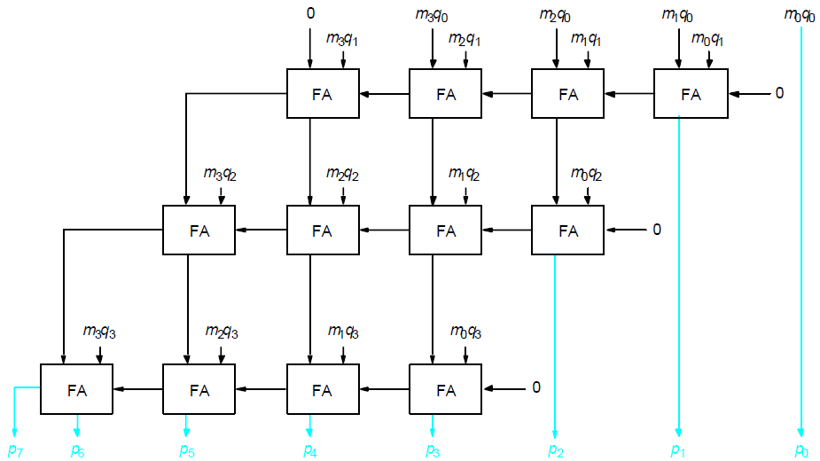
Carry-Save Addition of Summands
CSA speeds up the addition process.
P7
P6
P5
P4
P3
P2
P1
P0

Slide 24
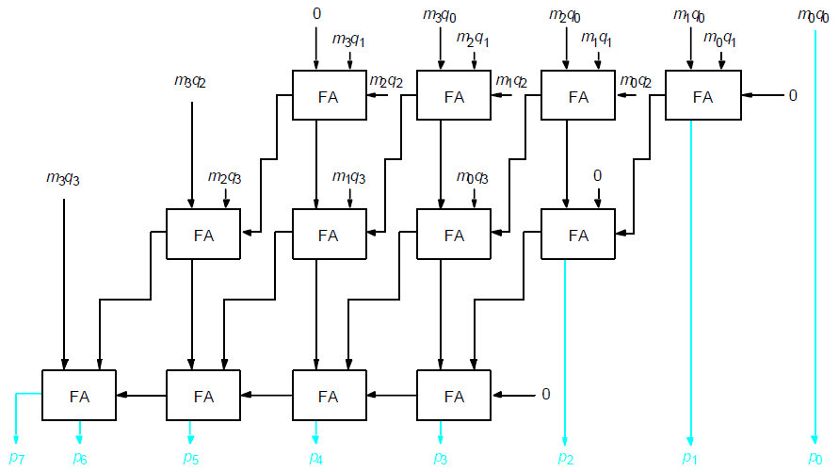
Carry-Save Addition of Summands(Cont.,)
P7
P6
P5
P4
P3
P2
P1
P0

Slide 25
Carry-Save Addition of Summands(Cont.,)
Consider the addition of many summands, we can:
Group the summands in threes and perform carry-save addition on each of these groups in parallel to generate a set of S and C vectors in one full-adder delay
Group all of the S and C vectors into threes, and perform carry-save addition on them, generating a further set of S and C vectors in one more full-adder delay
Continue with this process until there are only two vectors remaining
They can be added in a RCA or CLA to produce the desired product

Slide 26
Carry-Save Addition of Summands
1
0
1
1
0
1
(45)
M
X
1
1
1
1
1
1
(63)
Q
1
0
1
1
0
1
A
1
0
1
1
0
1
B
1
0
1
1
0
1
C
1
0
1
1
0
1
D
1
0
1
1
0
1
E
1
0
1
1
0
1
F
1
0
1
1
0
0
0
1
0
0
1
1
(2,835)
Product
Figure 6.17. A multiplication example used to illustrate carry-save addition as shown in Figure 6.18.

Slide 27
1
0
1
1
0
1
M
x
1
1
1
1
1
1
Q
1
0
1
1
0
1
A
1
0
1
1
0
1
B
1
0
1
1
0
1
C
1
1
0
0
0
0
1
1
S
1
0
0
1
1
1
1
0
0
C
1
1
0
1
1
0
1
D
1
0
1
1
0
1
E
1
0
1
1
0
1
F
1
1
0
0
0
0
1
1
S
2
0
0
1
1
1
1
0
0
C
2
1
1
0
0
0
0
1
1
S
1
0
0
1
1
1
1
0
0
C
1
1
1
0
0
0
0
1
1
S
2
1
1
0
1
0
1
0
0
0
1
1
S
3
0
0
0
0
1
0
1
1
0
0
0
C
3
0
0
1
1
1
1
0
0
C
2
0
1
0
1
1
1
0
1
0
0
1
1
S
4
+
0
1
0
1
0
1
0
0
0
0
0
C
4
1
0
1
1
0
0
0
1
0
0
1
1
Product
Figure 6.18. The multiplication example from Figure 6.17 performed using
carry-save addition.

Slide 28
Floating-Point Numbers and Operations

Slide 29
IEEE notation
IEEE Floating Point notation is the standard representation in use. There are two representations:
- Single precision.
- Double precision.
Both have an implied base of 2.
Single precision:
- 32 bits (23-bit mantissa, 8-bit exponent in excess-127 representation)
Double precision:
- 64 bits (52-bit mantissa, 11-bit exponent in excess-1023 representation)
Fractional mantissa, with an implied binary point at immediate left.
Sign Exponent Mantissa
1 8 or 11 23 or 52

Slide 30
Peculiarities of IEEE notation
Floating point numbers have to be represented in a normalized form to
maximize the use of available mantissa digits.
In a base-2 representation, this implies that the MSB of the mantissa is
always equal to 1.
If every number is normalized, then the MSB of the mantissa is always 1.
We can do away without storing the MSB.
IEEE notation assumes that all numbers are normalized so that the MSB
of the mantissa is a 1 and does not store this bit.
So the real MSB of a number in the IEEE notation is either a 0 or a 1.
The values of the numbers represented in the IEEE single precision
notation are of the form:
(+,-) 1.M x 2^{(E - 127)}
The hidden 1 forms the integer part of the mantissa.
Note that excess-127 and excess-1023 (not excess-128 or excess-1024) are used to represent the exponent.

Slide 31
Exponent field
In the IEEE representation, the exponent is in excess-127 (excess-1023)
notation.
The actual exponents represented are:
-126 <= E <= 127 and -1022 <= E <= 1023
not
-127 <= E <= 128 and -1023 <= E <= 1024
This is because the IEEE uses the exponents -127 and 128 (and -1023 and
1024), that is the actual values 0 and 255 to represent special conditions:
- Exact zero
- Infinity

